Slide 1
Using case to handle exceptions
…and be a wiseass
ryan urabe

Slide 2
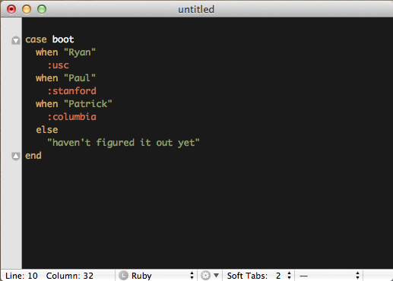
case

Slide 3
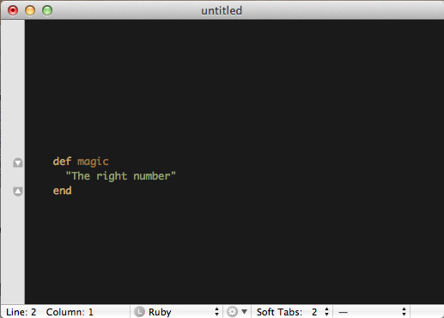
case in ‘numbers in words’

Slide 4
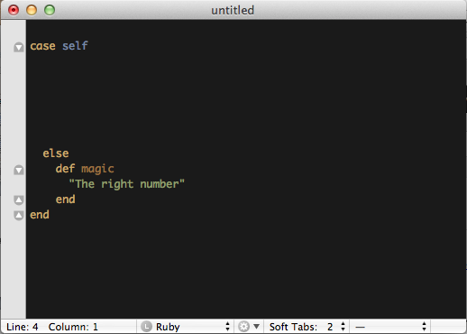
case in ‘numbers in words’

Slide 5
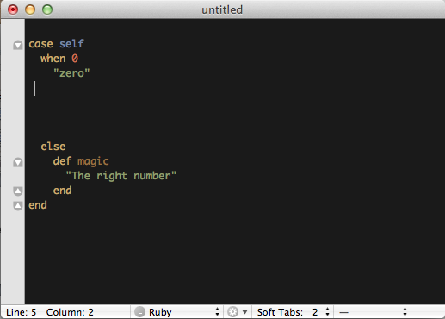
case in ‘numbers in words’

Slide 6
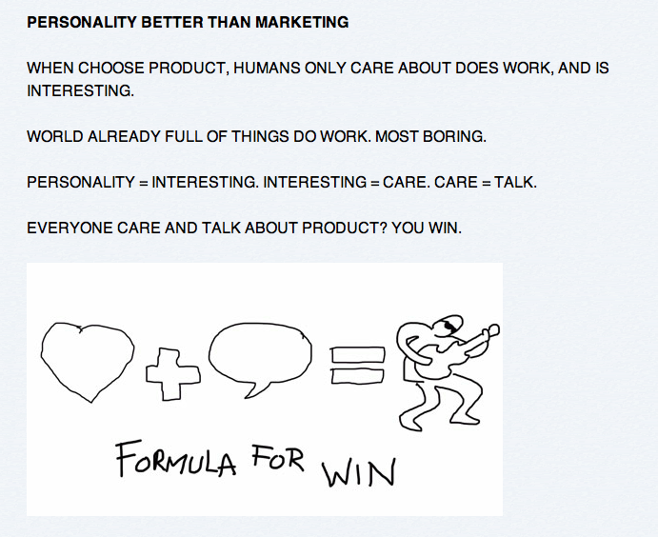

being a wiseass
personality
http://www.avc.com/a_vc/2011/09/minimum-viable-personality.html

Slide 7
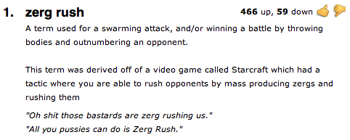
zerg rush

Slide 8
using case to be a wiseass

Slide 9
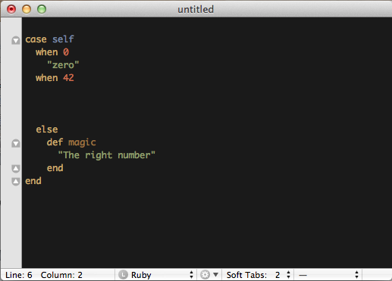
using case to be a wiseass

Slide 10
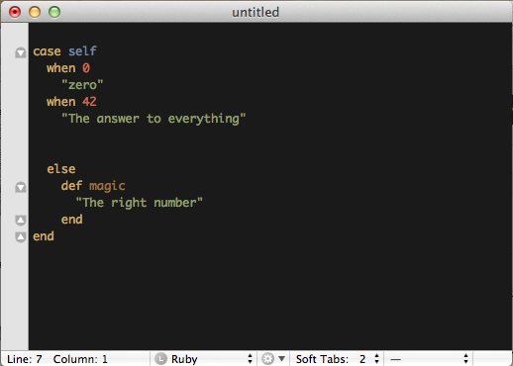
using case to be a wiseass

Slide 11
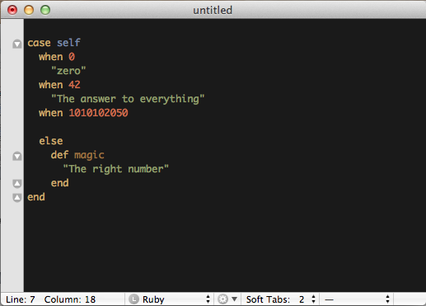
using case to be a wiseass

Slide 12
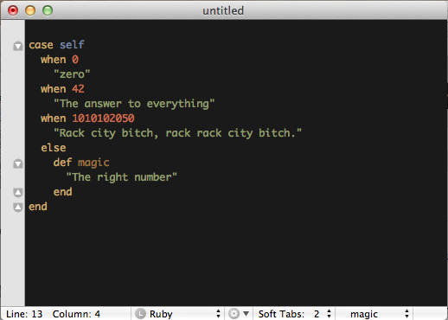
using case to be a wiseass

